Slide 1
VoIP based Train Control Communication system International Convention on Modern Train Control For Capacity & Safety Enhancement April 27 - 28, 2012 New Delhi
By
Yashpal Singh Tomar
Director Telecom RDSO

Slide 2
CONTENTS
What is train control communication system (TCCS) ?
Why it is unique?
The existing system.
Why IP based TCCS?
Challenges in IP based TCCS.
Design Philosophy and components of IP based TCCS.
Features of proposed IP based TCCS.

Slide 3
What is Train control communication System
Communication system between the controller and the various way-side stations.
It is used for Train operations.
Vital system.

Slide 4
Unique features
Omnibus communication circuit.
Omnibus Emergency communication circuit without any call signalling.

Slide 5
Existing Systems
Analog System providing omnibus functionality
DTMF signaling is used to draw attention of Way side station
No signaling from way station to Controller.
Way station are always connected to controllers conference circuit and by lifting the handset communication starts

Slide 6
Why IP based system
Limitations of Present System
Meets basic requirements with few features for user.
Addition of new feature is very difficult.
Equipments and arrangement Railway specific.

Slide 7
Why IP based system
Advantages/ Possibilities in IP based System
Feature rich communication
Use of Commercially available Off the shelf (COTS) products
Packet based communication, enabling use of common infrastructure for data, voice and video communication.

Slide 8
Challenges in IP based System
Emulation of Omnibus functionalities
Integration of existing emergency communication system without changing the Emergency telephones.

Slide 9
Design Philosophy
Centralised Communication and application server.
Provision for Disaster recovery server
Centralised conference bridge
Gateways at way station for integration with emergency communication.
Gateways also provide remote surviability
Feature rich user interface in the form of console for the key user i.e. controller.

Slide 10
Various Components of the Proposed system
Server Block | Call control
 | Conferencing
 | Network management
 | Voice recording
 | Other Applications
Gateways | To connect Railway Exchange
 | To provide Analog Telephones
 | To integrate emergency Communication
 | SMS gateway
Controllers Console
IP telephones/ Consoles for ASMs

Slide 11
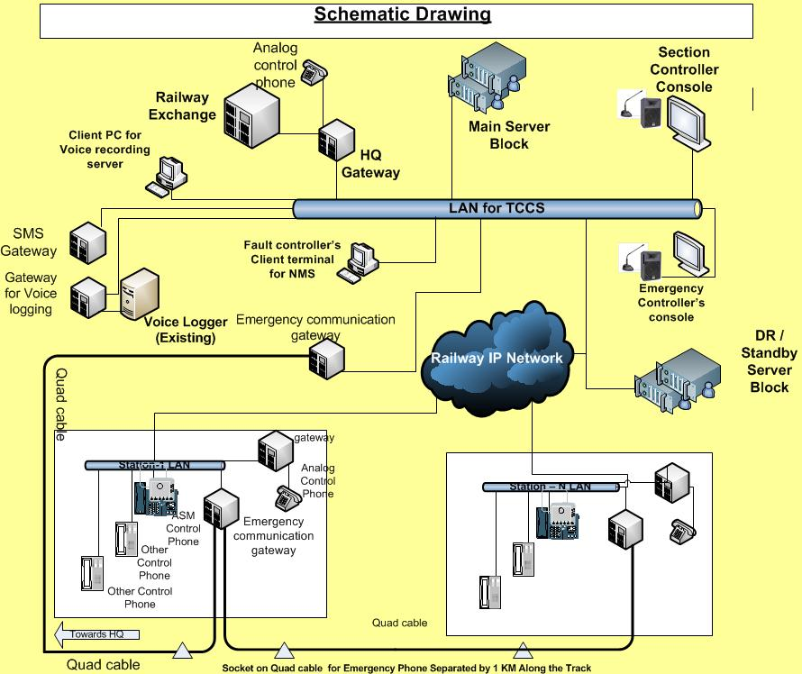

Slide 12
FEATURES FOR USERS
Controller’s Console
Touch screen panel
One touch dialing by name of the stations
Status of various station like busy, free, not reachable
Information regarding stations currently in conference
Caller ID, Call log, Call record
Group dialing
Sending SMS notification by touch of a button

Slide 13
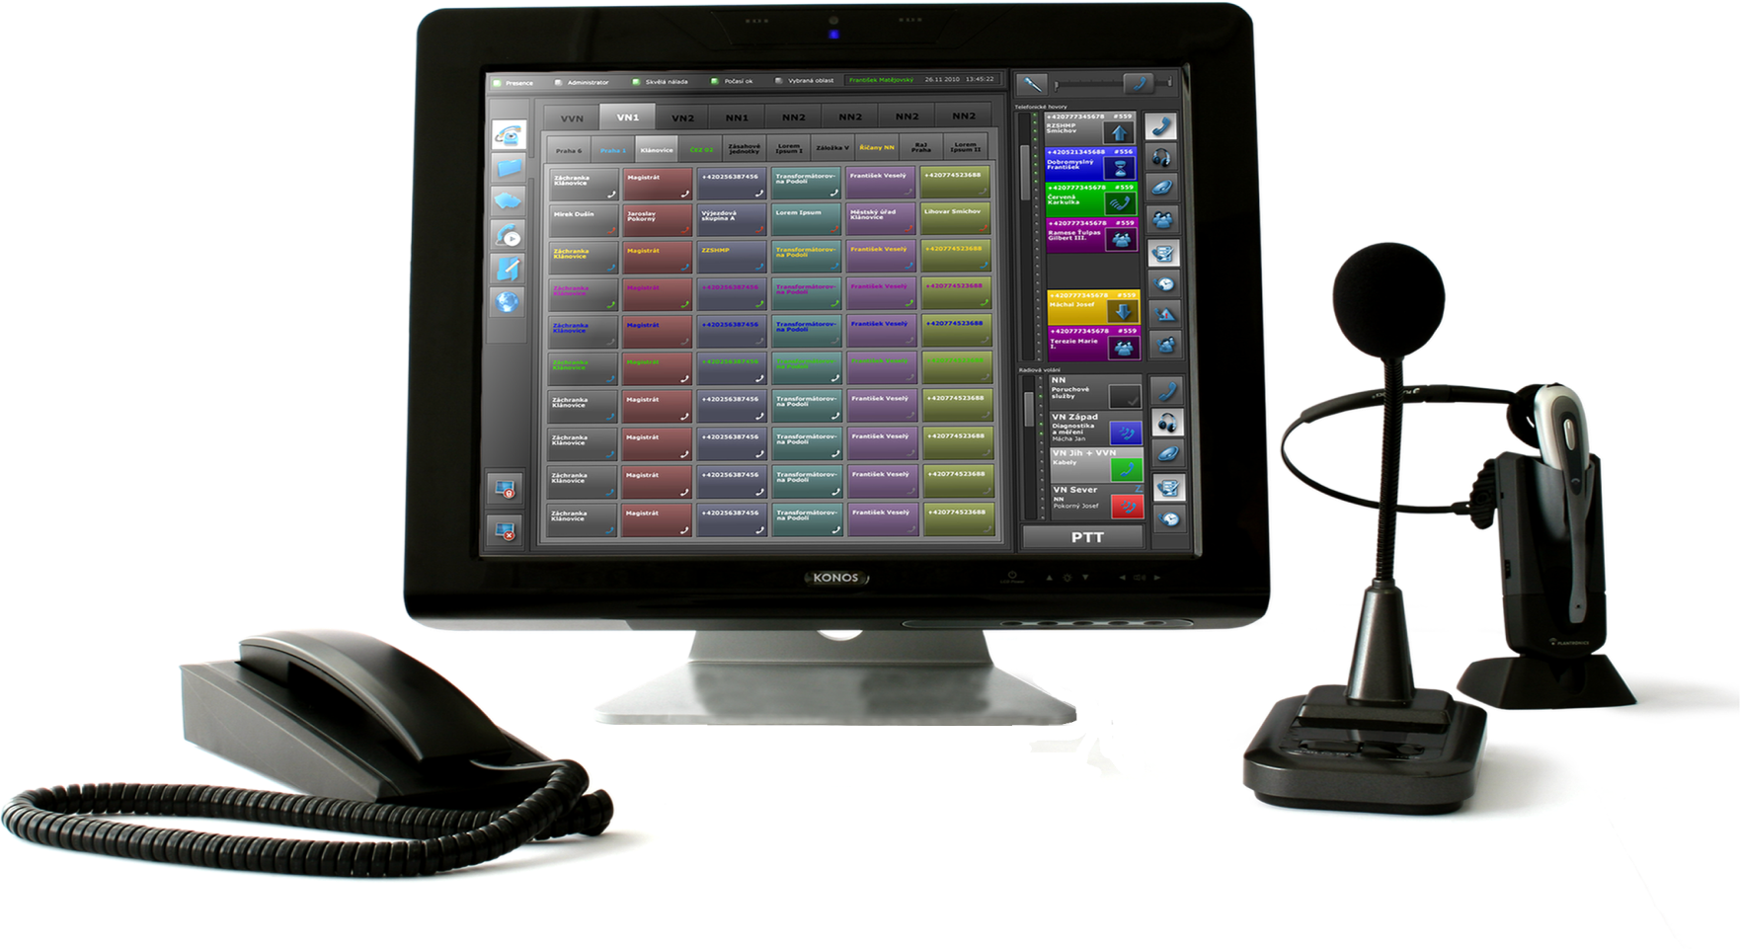
Controller’s console may look like

Slide 14
FEATURES FOR USERS
ASM’s IP Telephone/ Console
Common single equipment for all controls
Distinctive call ring from Section Controller
Shortcut dialing buttons for calling various controllers
Incoming call alert from section controller even when the phone is busy or off hook
Caller ID, Call log, Missed call details

Slide 15
RELIABILITY FEATURES
Redundant server block
Dual Ethernet ports in servers and consoles for fault tolerant working
Way station gateways with remote survivability feature.
Higher priority for ASM’s call and emergency call in case of WAN bandwidth constraint.
Power over Ethernet for IP telephone

Slide 16
SECURITY FEATURES
Servers to have inbuilt protection against DoS attack and Intrusion
Controlled access to call server based on ACL
Separate VLAN for Voice
Secure configuration using SSH
Authentication of endpoints based on 802.1x

Slide 17
SOME MORE FEATURES
Communication protocols: SIP and H.323
Uniform Distribution of time through NTP
SMS alert for faults/ alarm
Centralised Network management mainly for fault and configuration management
Voice logging with record search on the basis of caller, called party, time range or date range criteria.
SMS alert by voice logger also.
Plug and play functionality for IP phones during replacement

Slide 18
STATUS
Feasibility established through Poof of Concept trial.
Draft specification is prepared and to be issued shortly.

Slide 19
THANKS

